Slide 1
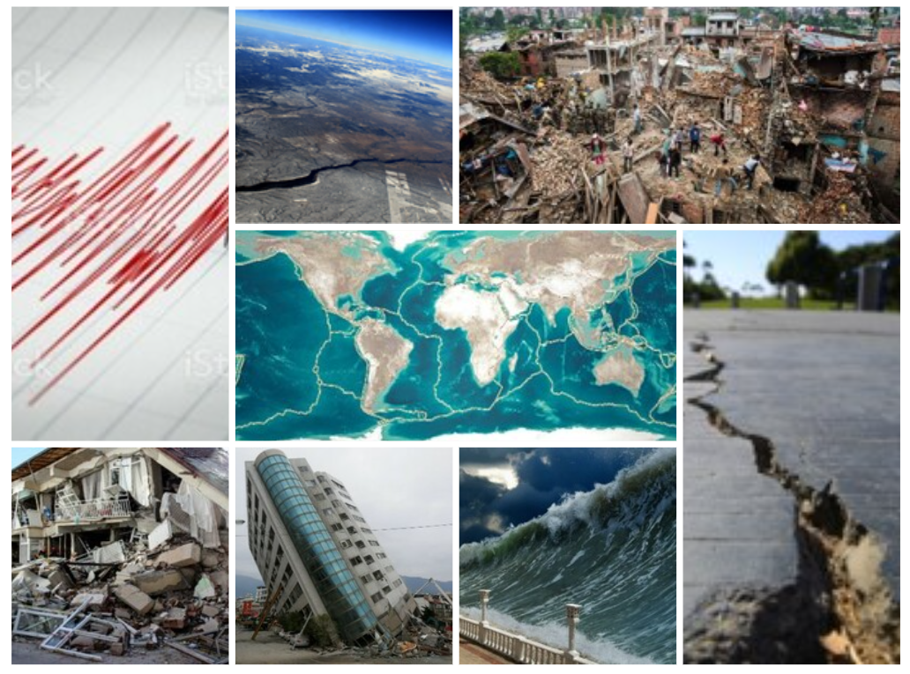
Earthquakes over the world
data mining and machine learning final project
Bar Benezri
Tal Beno

Slide 2
לשימוש פנימי בלבד
תכנון נכון (מחקר מעמיק, לשאול שאלות ולקבל תשובות, מסקנות) 15 נקודות
רכישת מידע (API) דטה בייס קיים לא מזכה בניקוד מלא 15 נקודות
הבנת הידע וטיפול בו (כפילויות, חוסרים, outliners ) 15 נקודות
ביצוע תהליך למידת מכונה והסקת מסקנות 15 נקודות
הבנה נכונה של החומר המוצג 15 נקודות
איכות המצגת 10 נקודות
הצגה לכיתה (לא יאוחר מ 12 לינואר 2021 ) 5 נקודות
רכישת מידע בצורה ייחודית (crawling or other very special handling) 10 נקודות
אפקט וואו 5 נקודות
מקוריות 10 נקודות
סטודנט יחיד 5 נקודות

Slide 3

Our research - intro
Research questions:
Can we predict when, where or how powerful will the next earthquake be?
What pattern can we observe and what conclusions can we learn from it? (according to data)
Data Acquisition
EDA
ML
Conclusions

Slide 4

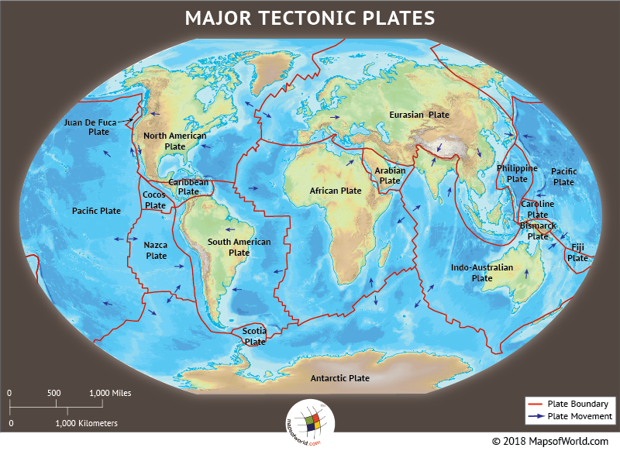
Data sources
API
United States Geological Survey
Crawling
Wikipedia
German Research Centre for Geosciences
Data acquisition
EDA
WOW effect
Conclusion
ML

Slide 5

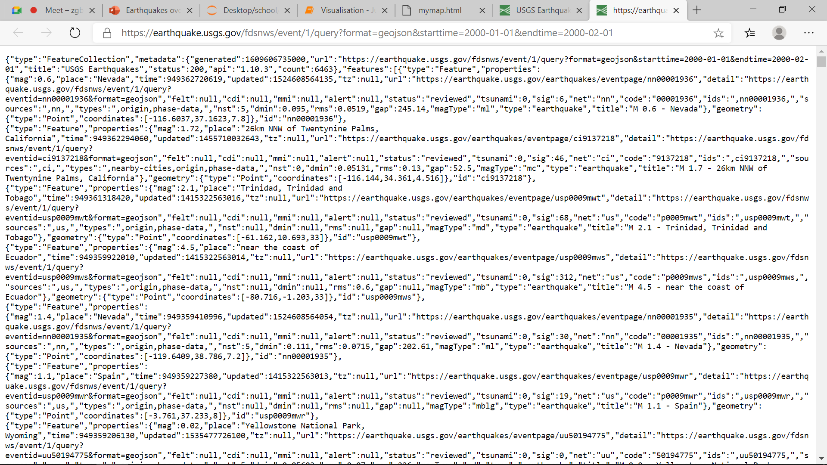
USGS - API
We used a built-in API of USGS
Since retrieving all the data at once is forbidden, we wrote a script that runs all over the DB and retrieve all records by dates
Finally, it concatenated into `df_api` dataframe
Data acquisition
EDA
WOW effect
Conclusion
ML

Slide 6

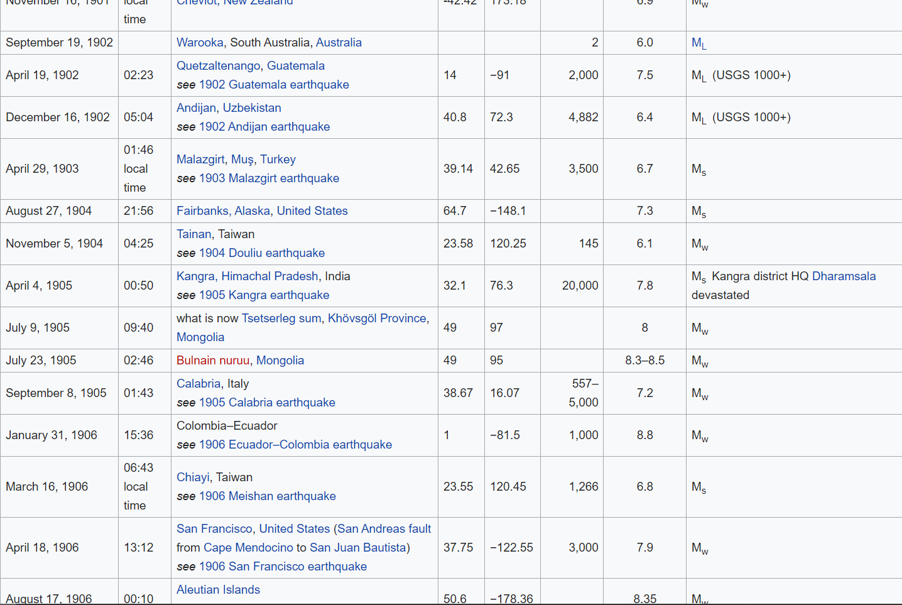
Wikipedia - scraping
We used a built-in function from `pandas` to crawl the relevant tables of Wikipedia
Finally, the records saved into `df_wiki` dataframe
Data acquisition
EDA
WOW effect
Conclusion
ML

Slide 7
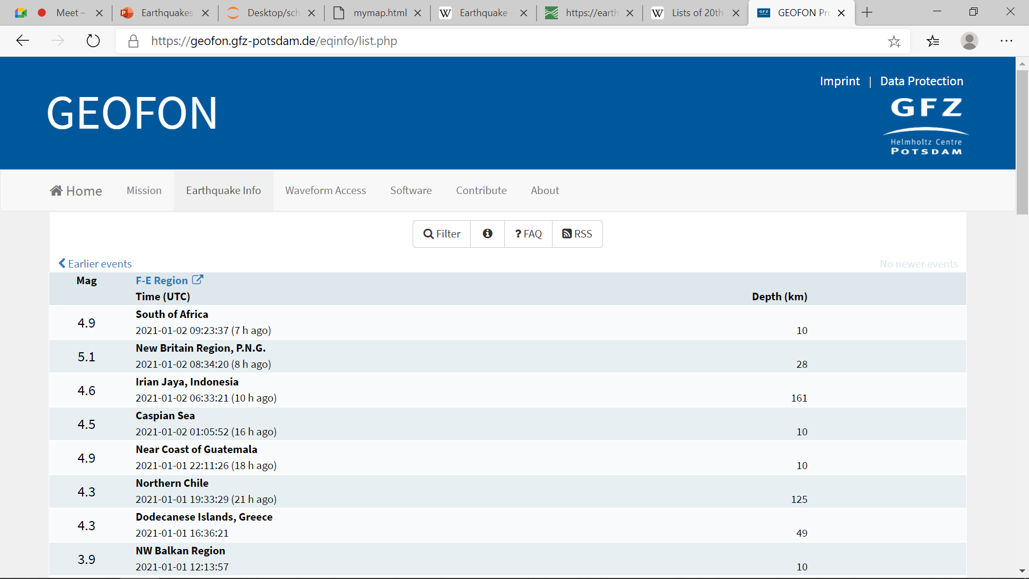
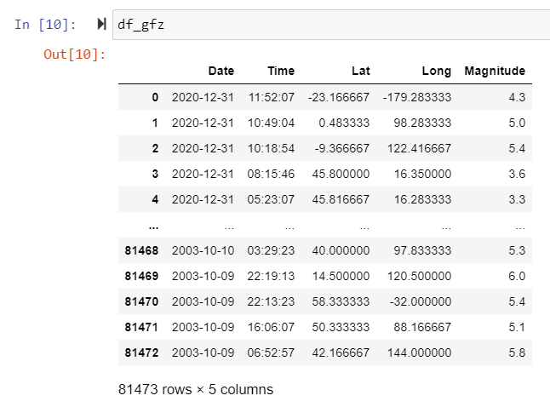
GFZ - crawling
We used `BeautifulSoup` library to crawl the relevant records of GFZ
Finally, the records saved into `df_fgz` dataframe
Data acquisition
EDA
WOW effect
Conclusion
ML

Slide 8

EDA
Concatenation of all the information into one table while adjusting the columns into a uniform format
Filter duplicates and empty values
Outliners handling
Data acquisition
EDA
WOW effect
Conclusion
ML

Slide 9
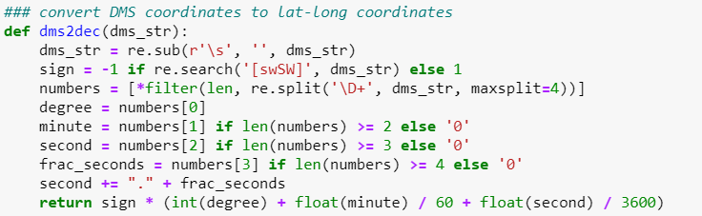

EDA – data merge
Different formats
Dates
dd\mm\YYYY
dd, mm YYYY
mm-dd-YYYY
Locations
DMS
LAT-LONG
Strings that contain ranges instead of integers, or characters that damaged the information quality
Data acquisition
EDA
WOW effect
Conclusion
ML

Slide 10

EDA – filter
The raw information was retrieved from 3 different sources – we expected duplicates
We estimated that the chance of two earthquakes to occur at the same day and time in two different places around the world is nil so these records were filtered
Records that were missing date and location data were incapable of analysis and were also filtered
The information was filtered from about 2.3M records to 88K
Data acquisition
EDA
WOW effect
Conclusion
ML

Slide 11
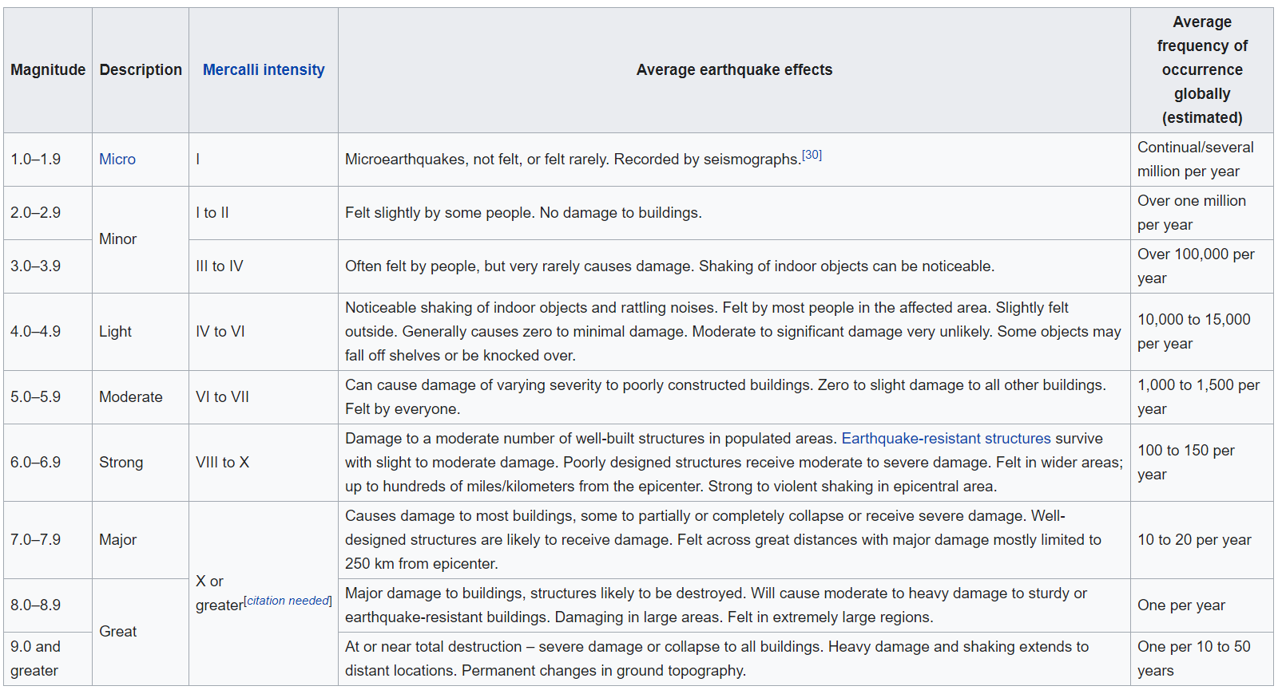
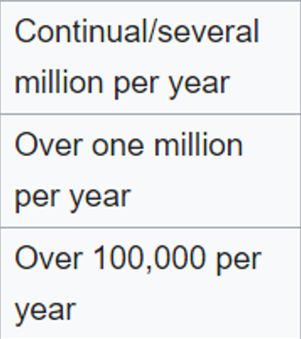
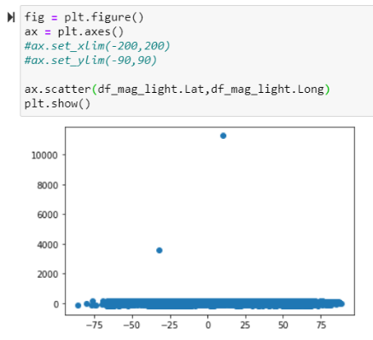
EDA – outliners
Due to the fact that earthquakes with a magnitude of less than 3 occur a considerable number of times a year and can not contribute information, we analyzed by earthquakes above magnitude 3
We chose to transfer the information to LAT-LONG format when the range of values is LAT (± 90) LONG (± 180)
We found 3 exceptional values (1000+) using scatterplot and removed them
Data acquisition
EDA
WOW effect
Conclusion
ML

Slide 12
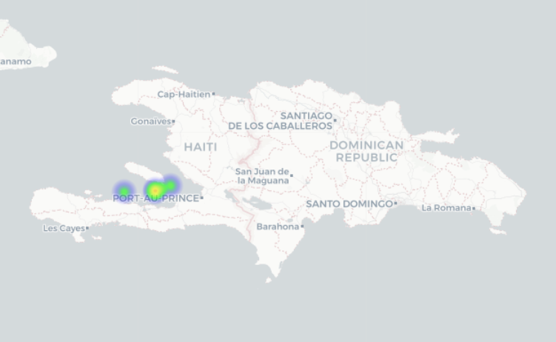
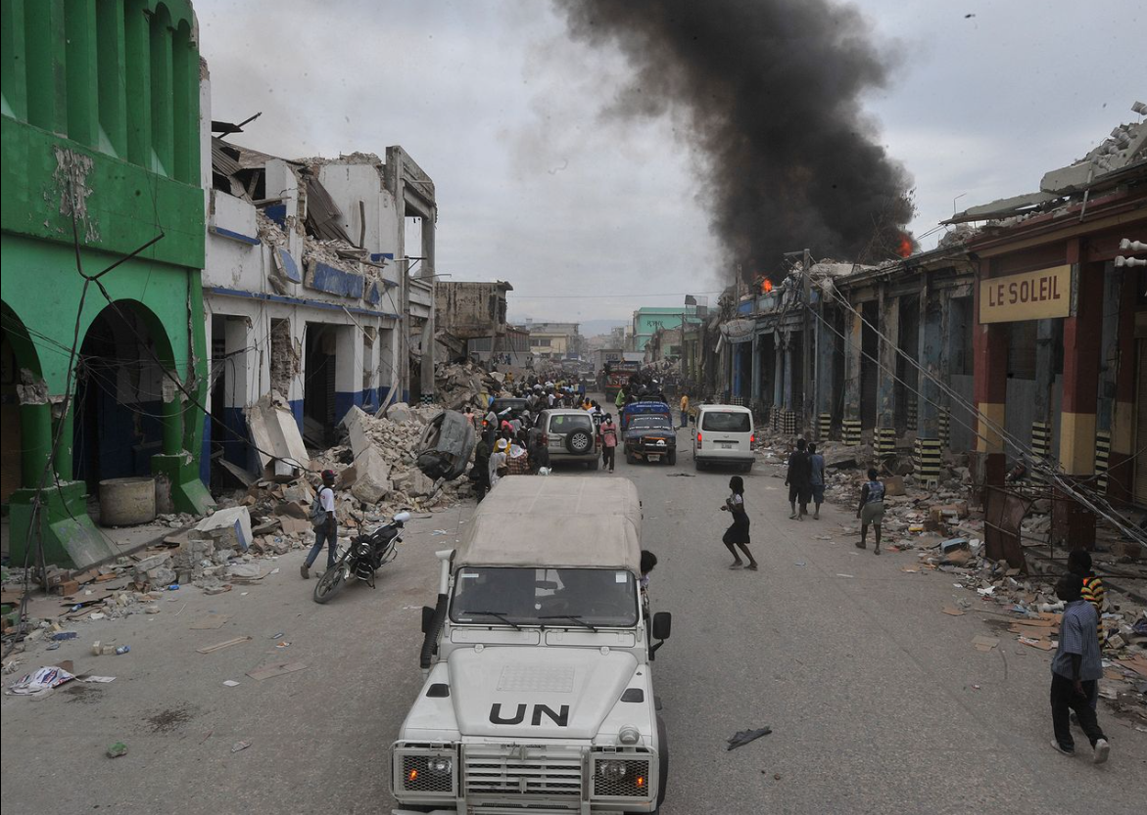
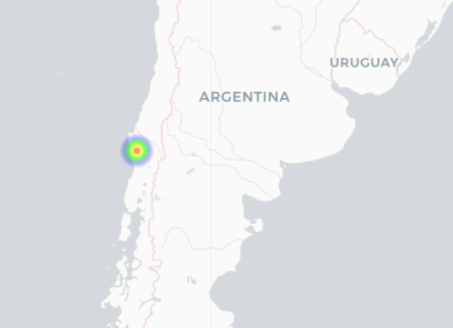
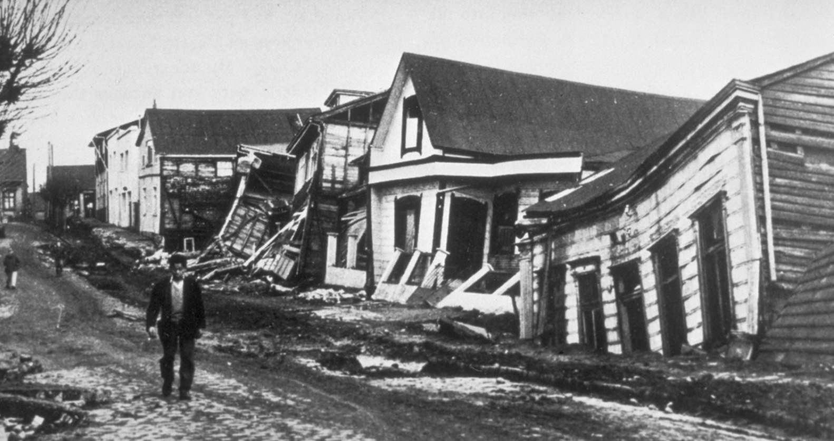
Conclusion – earthquakes examples
Haiti Earthquake (2010)
An earthquake on Haiti, east of Central America, at 2010, with a magnitude of 7.0 on the Richter scale that took the lives of 230,000 people
The earthquake in Vladivostok (1960)
The 1960 earthquake in Chile of South America, was the strongest earthquake recorded with a magnitude of 9.5 on the Richter scale that took the lives of 6,000 people
Data acquisition
EDA
WOW effect
Conclusion
ML

Slide 13
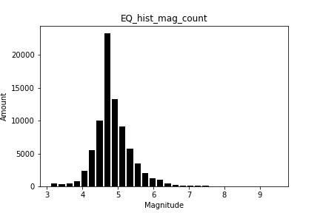
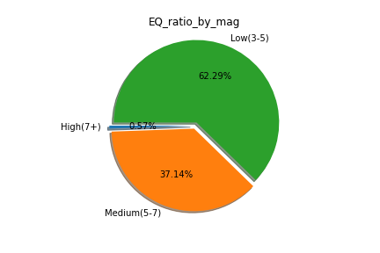
Conclusion – earthquakes amount
Name
Line graph that compares the amount of earthquakes and their magnitude
What does the graph contain
X-axis the magnitude of the earthquakes
Y-axis the amount of the earthquakes
Conclusion
A left-leaning bell graph can be seen here showing that there are more weak-to-medium than strong earthquakes
Name
Pie chart showing the ratio of the amount of earthquakes What does the graph contain
Weak earthquakes (3-5) are colored in green
Medium earthquakes (5-7) are colored in orange
Strong earthquakes (7+) are colored in blue
Conclusion
There is a dissonance between the frequency and magnitude of earthquakes
Data acquisition
EDA
WOW effect
Conclusion
ML

Slide 14
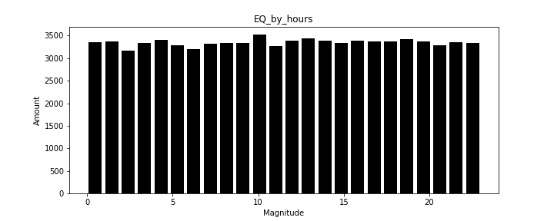
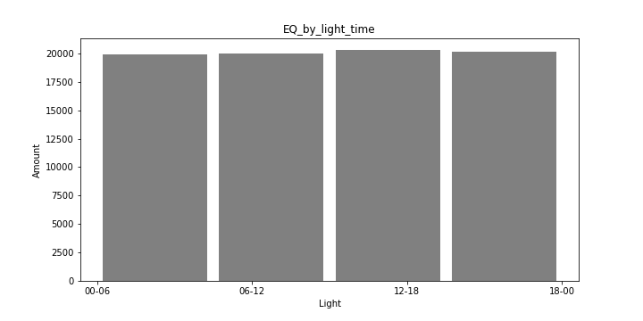
Conclusion - daytime
Name
A hist graph that compares the amount of earthquakes to the daytime hours
What does the graph contain
Axis-X, 24-hour layout Axis-Y the amount of earthquakes
Conclusion
There is no correlation between the hours of the day and the number of earthquakes
There is no basis for this claim, the distribution is more similar to a uniform distribution
In the 1920s scientists believed that there was a direct connection between the hours of the day and the amount of earthquakes. Sources: Article 1, Article 2
Name
A hist graph that compares the amount of earthquakes to the daytime hours
What does the graph contain
Axis-X, 24-hour daylight layout Axis-Y the amount of earthquakes
Conclusion
There is no correlation between the daylight hours and the number of earthquakes
Data acquisition
EDA
WOW effect
Conclusion
ML

Slide 15
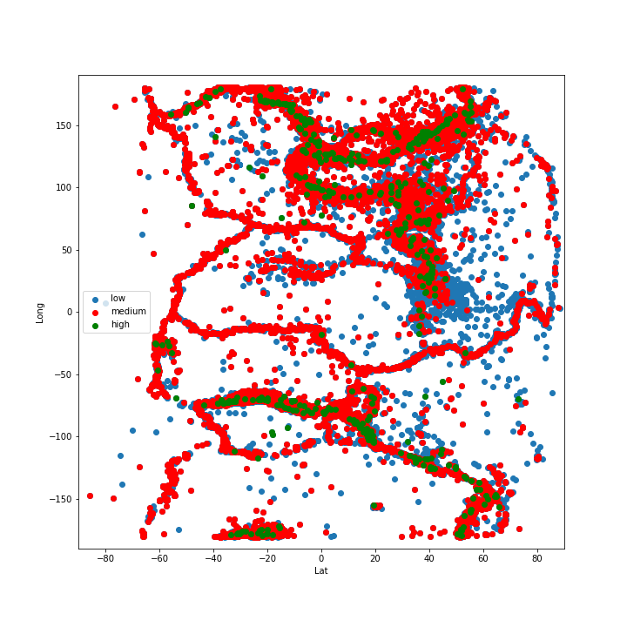
Conclusion - Scattering
Name
A world map scatterplot divided by earthquake magnitudes
What does the graph contain
X-axis for LAT values
Y-axis for LONG values
earthquakes are divided into colors:
blue (3 - 5)
red (5 - 7)
green (7+)
Conclusion
We have chosen to emphasize the strongest earthquakes to show that the source of the medium and weak earthquakes is from these points
Data acquisition
EDA
WOW effect
Conclusion
ML

Slide 16
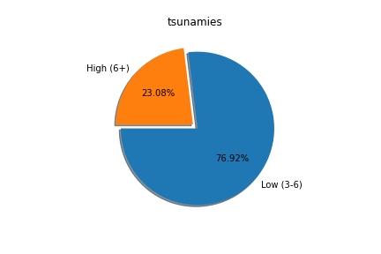
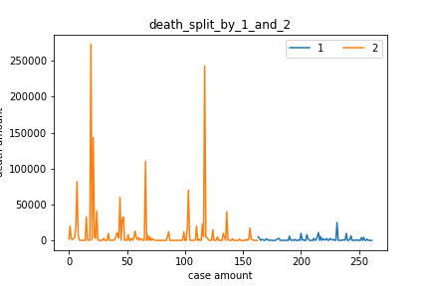
Conclusion – tsunami and deaths
Name
A pie chart showing the recorded tsunamis, broken down by what earthquake caused them
What does the graph contain
In blue - the tsunamis formed as a result of a weak earthquake
(3 - 6)
In orange - the earthquakes created by a strong earthquake (6+)
Conclusion
There is no correlation between the magnitude of the earthquake and the occurrence of a tsunami, the main variable for creating a tsunami is whether the location of the earthquake is near a beach
Name
Line chart showing the amount of the dead compared to the magnitude of the earthquake
What does the graph contain
X-Axis - the number of cases documented
Y-Axis - the number of deaths records
Colored Orange - strong earthquakes (6+)
Colored Blue - weak earthquakes (3-6)
Conclusion
There seems to be a direct correlation between the amount of deaths caused by a tsunami, and the magnitude of the earthquake
Data acquisition
EDA
WOW effect
Conclusion
ML

Slide 17

Machine Learning
Data acquisition
EDA
WOW effect
Conclusion
ML

Slide 18
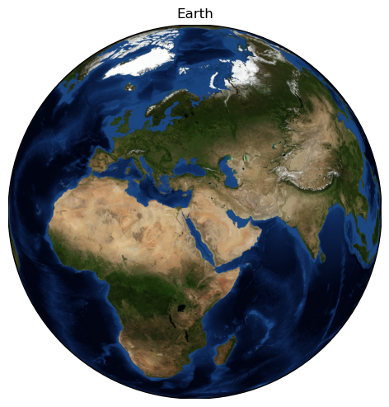
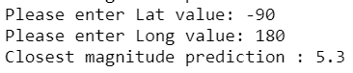
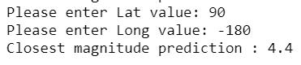



ML – linear regression
Using `sklearn` library and linear regression we were able to train a model that predicts the magnitude of the next earthquake
The model predicted that the more southeast the place, the weaker the earthquake that is expected to occur
Data acquisition
EDA
WOW effect
Conclusion
ML

Slide 19
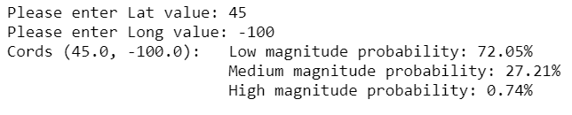
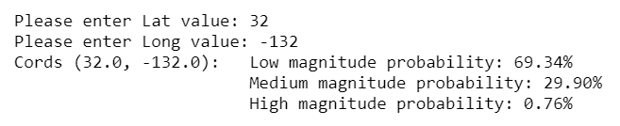
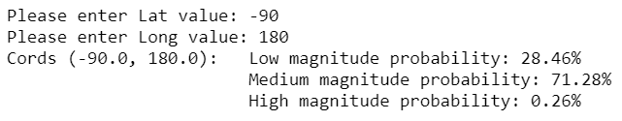
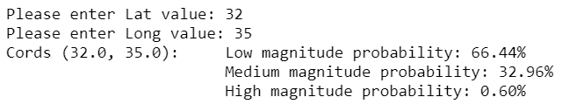
ML – logistic regression
Using `sklearn` library and logistic regression, we were able to train a model that predicts the probability of low, medium and high magnitude of the next earthquake
USA yellow stone
Japan, which is considered a major earthquake hotspot and Yellowstone Park in the U.S. have had a high chance of strong earthquakes
Japan
הקוטב הדרומי
The South Pole, which is not above any tectonic plate, has had low chances
ישראל
Israel, which is above the Great Rift Valley, has received above-average chances
Data acquisition
EDA
WOW effect
Conclusion
ML

Slide 20
Wow1
Data acquisition
EDA
WOW effect
Conclusion
ML

Slide 21
Wow2
Data acquisition
EDA
WOW effect
Conclusion
ML

